Slide 1
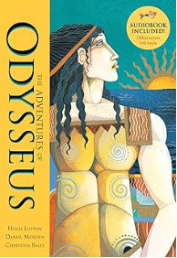
This term in Year 5 our topic will be ‘Brave Greeks’
English
We will be reading ‘Odysseus’ by Hugh Lupton, Daniel, Morden, and Christina Balit. We will be writing myths and letters.
Spanish
In our unit ‘Presenting Myself’ we will be learning about pronouns and introductions.
Key Information
Start of Day - 8:45 am
Land Event - 3.2.25 @ 2:45-3:15pm
Trips – TBC
* Make sure to check Class Dojo for updates and messages from the Year 5 team
Maths
We will be continuing to look at multiplication and division, then moving onto fractions.
Art
We will be applying our sketching skills by designing and creating Greek pottery.
Science
Our science topic is ‘Irreversible and Reversible Changes’
Computing
We will be learning about flat file databases.
Home Learning
In year 5 we expect children to:
Complete 5x reading (10minutes) a week
Times table practice
Spelling practice
History
We will be learning about the Greeks.
Learn Together
Our Value for this term is ‘Courage’. We will be looking at ethics and the environment and continuing to learn about Zones of Regulation.
Useful links and resources
Maths
https://whiterosemaths.com/parent-resources
Times Tables Rock Stars – Times Tables Rock Stars (ttrockstars.com)
English
https://www.bransty.cumbria.sch.uk/wp-content/uploads/2019/01/KS2-Reading-Vipers-question-examples.pdf
https://www.spellingshed.com/en-gb/
.
PE
In indoor PE, we will be swimming. We will be learning how to play Outdoor and Adventurous Activity (OAA in our outdoor PE session.

