Slide 1
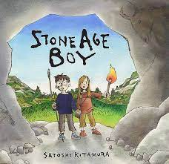
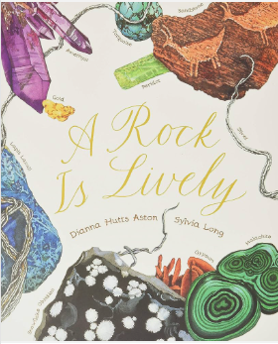
This term in Year 3 our topic will be ‘Food and Shelter’
Learn Together
Our Value this term is Community. We will be looking at the Zones of Regulation and how these can be applied in class.
English
We will be reading ‘Stone Age boy’ and ‘A Rock is Lively.’ We will be writing our own narrative and set of instructions.
Spelling/Phonics
Phoneme recognition continued alongside weekly spelling tests.
*See Year 3 page on website for more details.
Science
We will be learning about Rocks. We will be finding out how fossils are formed, compare different rocks and recognise different soil
History
Stone Age to Iron Age. We will learn about what life was like in prehistoric Britain.
Our school value this term is: Community.
PE
Dance
Cooperative Learning
Key Information
Harvest festival- 17.10.23
Land Event – 12.10.23
Trip/workshops: 12.10.23- Netham Park
Spanish
We will be looking at greetings- Los Saludos
Maths
We will be looking at Place Value and Addition and Subtraction.
Useful links and resources
Maths
Hit the Button - Quick fire maths practise for 6-11 year olds (topmarks.co.uk)
Times Tables Rock Stars – Times Tables Rock Stars (ttrockstars.com)
.
Home Learning
In year 3 we expect children to:
Read x5 a week
Times table practice
Spelling practice
Art
Cave paintings
Anish Kapoor- Sculpture

