Slide 1
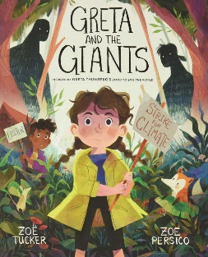
This term in Year 3 our topic will be ‘Environment’
Geography
Locational knowledge
Worlds countries- we will be learning to identify and locate the seven continents and countries within each one.
Learn Together
We will be looking at Ethics and the Environment and build on their understanding of environmental issues
English
We will be reading ‘Greta and the Giants’ and ‘Dear Earth.’ We will be writing a letter and descriptive poetry’
Spelling/Phonics
Phoneme recognition continued alongside weekly spelling lessons and tests.
*See Year 3 page on website for more details.
Science
We will be learning about plants. The children will work scientifically and collaboratively to investigate what plants need to grow well. They will work in a hands- on way to identify parts of a flower.
Our school value this term is: Compassion
PE
Gymnastics
Catching and throwing
Spanish
Aprendo Español– I am learning Spanish
Maths
We will be looking at Addition and Subtraction and Multiplication. We will continue to focus on our 2, 3 and 5 times tables.
Key Information
Land Event – TBC
Trip/workshops: TBC
Useful links and resources
Maths
Hit the Button - Quick fire maths practise for 6-11 year olds (topmarks.co.uk)
Times Tables Rock Stars – Times Tables Rock Stars (ttrockstars.com)
8 Times Table Song (Cover of Rolling In The Deep by Adele) - YouTube
.
Home Learning
In year 3 we expect children to:
Complete 5x reading a week
Times table practice
Spelling practice
DT
Textiles 2D to 3D product

