Slide 1
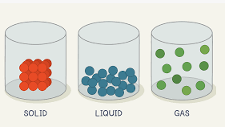
This term in Year 4 our topic will be ‘Brave Vikings.’
History
We will be finding out about Vikings raids and Danelaw. We will find out how England became one unified country.
Learn Together
This term’s religion is Christianity.
We will be learning about the power of forgiveness.
Science
We will be learning about solids, liquids and gasses. We will be also planning a melting experiment.
English
We will be reading ‘Erik the Viking’ and writing our own legends and creating persuasive posters.
Spelling/Phonics
*See Year 4 page on website for weekly spellings for this term.
Our school value this term is: Courage
PE
Gymnastics
4 square-taught by Freya
Maths
We will be looking be continuing multiplication ad division. We will multiply and divide whole numbers by 10 and 100.We will use formal methods of multiplication and subtraction.
We will be learning about length and perimeter.
Art
We will be looking a sculpture techniques and using card to create a Viking longship from a net.
Spanish
Los Super Heroes
En mi pueblo
Key Information
Land Event – Not this term
Trip/workshops: TBC
Useful links and resources
Maths
Hit the Button - Quick fire maths practise for 6-11 year olds (topmarks.co.uk)
Times Tables Rock Stars – Times Tables Rock Stars (ttrockstars.com)
8 Times Table Song (Cover of Rolling In The Deep by Adele) - YouTube
.
Home Learning
In year 4 we expect children to:
Complete 5 x reading a week
Times table practice
Spelling practice

